Slide 1
COVID disease
Shai Level 2 Training
Deep learning project

Slide 2
hello!
We are
Wesam Alsohle & Debbeh Zazza
We are here because We Want to give presentations about our Deep learning project.

Slide 3
Roadmap
Frame the problem and look to the big picture
Prepare the data.
Fine tune the final model.
1
3
5
2
4
6
Explore the data to gain insights.
Train different models.
Evaluation and solution.

Slide 4
Our process is easy
Explore
data folders
& Visualization
Transfer learning from pre-trained models
Fune tune the model and
Evaluation

Slide 5
1.
Frame the problem and look to the big picture
Image classification of Chest X Rays in one of three classes:
Normal, Virus, COVID

Slide 6
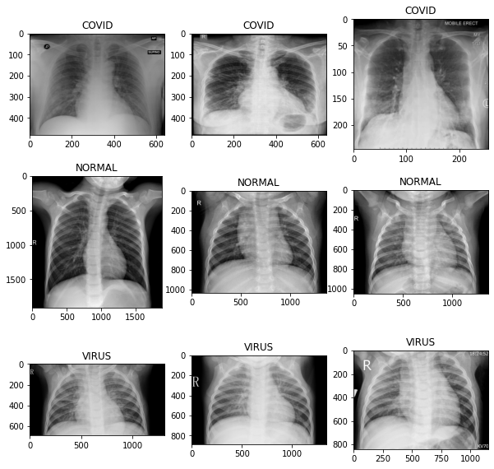
It is clear that images have different sizes!

Slide 7
2.
Explore the data to
gain insight

Slide 8
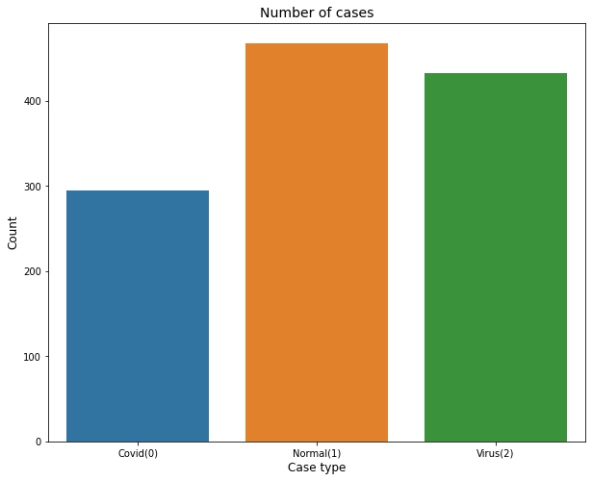
Covid: 295 Normal : 468 Virus: 433

Slide 9
3.
Prepare the data

Slide 10
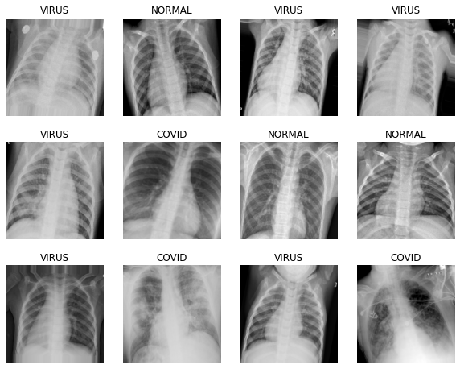
ImageDataGenerator
rescale=1./255
validation_split=0.2
shear_range=0.2
zoom_range=0.2
horizontal_flip=True
rotation_range=15
fill_mode="nearest"

Slide 11
split the data
Training set
958 Sampels
training_set = train_datagen.flow_from_directory
(train_dir,
subset='training',
target_size = (image_size, image_size),
batch_size = BATCH_SIZE,
class_mode = 'categorical',
shuffle=True)
Validation set
238 Sampels
validation_set = train_datagen.flow_from_directory
(train_dir,
subset='validation',
target_size = (image_size, image_size),
batch_size = BATCH_SIZE,
class_mode = 'categorical',
shuffle=True)

Slide 12
4.
Transfer learning Pre-Trained Models for Image Classification

Slide 13
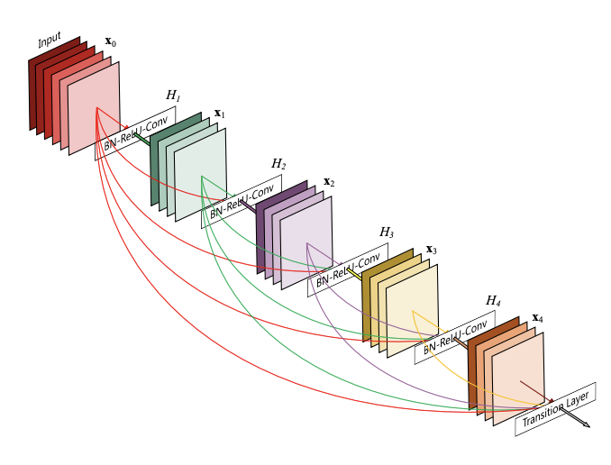
Dense Convolutional Network (DenseNet)

Slide 14
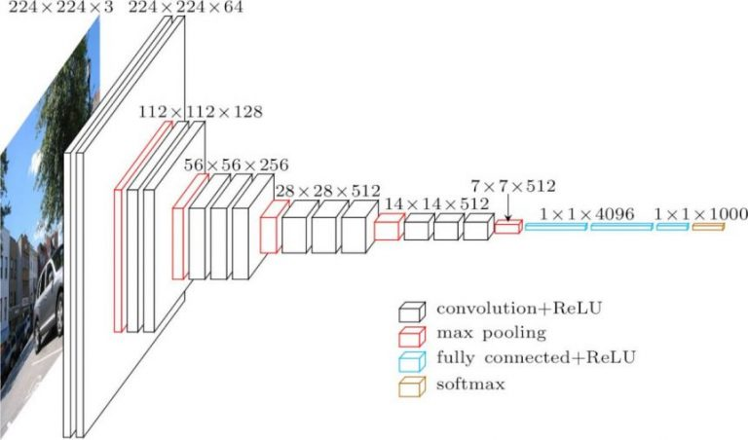
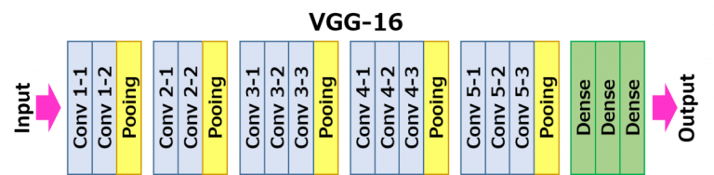
(VGG-16)
loss: 0.4346 - accuracy: 0.9489 val_loss: 0.3939 - val_accuracy: 0.9622

Slide 15
4.
Fine tune The model & Evaluation

Slide 16
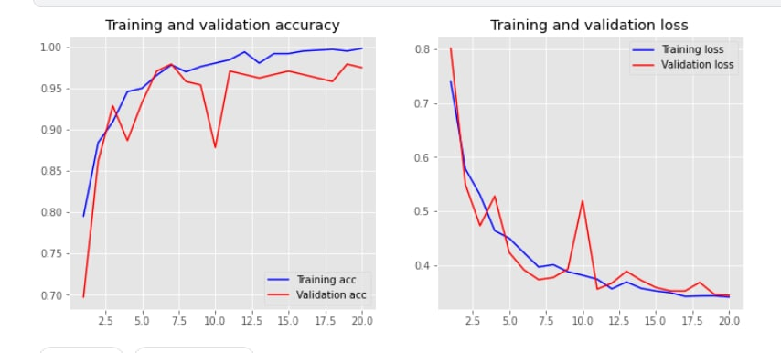
Network (ResNet50)
loss: 0.3310 - accuracy: 0.9979 val_loss: 0.3442 - val_accuracy: 0.9748

Slide 17
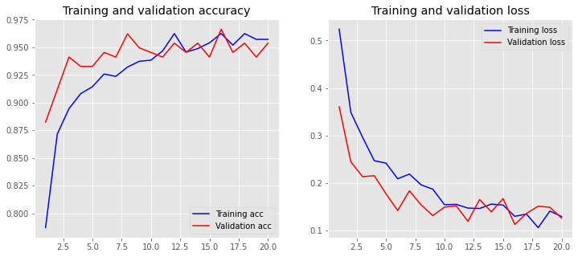
loss: 0.1294 - accuracy: 0.9572 val_loss: 0.1260 - val_accuracy: 0.9538
VGG-16 & DenseNet

Slide 18
thanks!
Any questions?

